Slide 1


Insertion & Quick Sort Data Structures and Algorithms
Cindy Hapsari / 2215101032
Chiko Gita Satria / 2215101053
Wiswa Nath / 2215101014

Slide 2


Insertion Sort
Insertion sort is a simple sorting algorithm that builds the final sorted array one item at a time. It works by iterating through the array and inserting each element into its proper position within the sorted portion of the array.
The algorithm starts with the second element of the array and compares it with the elements before it, shifting them to the right if they are greater than the current element. This process continues until the current element is in its correct position. The algorithm then moves on to the next element and repeats the process until the entire array is sorted.
The time complexity of the insertion sort algorithm is O(n^2) in the worst and average cases, where n is the number of elements in the array.

Slide 3
Quick Sort
Quick sort is a widely used sorting algorithm that employs a divide-and-conquer approach to sort an array or a list of elements. It is an efficient algorithm with an average time complexity of O(n log n) and performs well on large datasets.
The key step in quick sort is the partitioning process. It rearranges the array in such a way that elements smaller than the pivot come before it, and elements greater than the pivot come after it. After partitioning, the pivot is in its final sorted position, and it will not change during subsequent iterations.
The time complexity of the quick sort algorithm depends on several factors, including the choice of pivot and the initial ordering of the elements in the array. In the average case, quick sort has a time complexity of O(n log n), where n is the number of elements in the array.

Slide 4
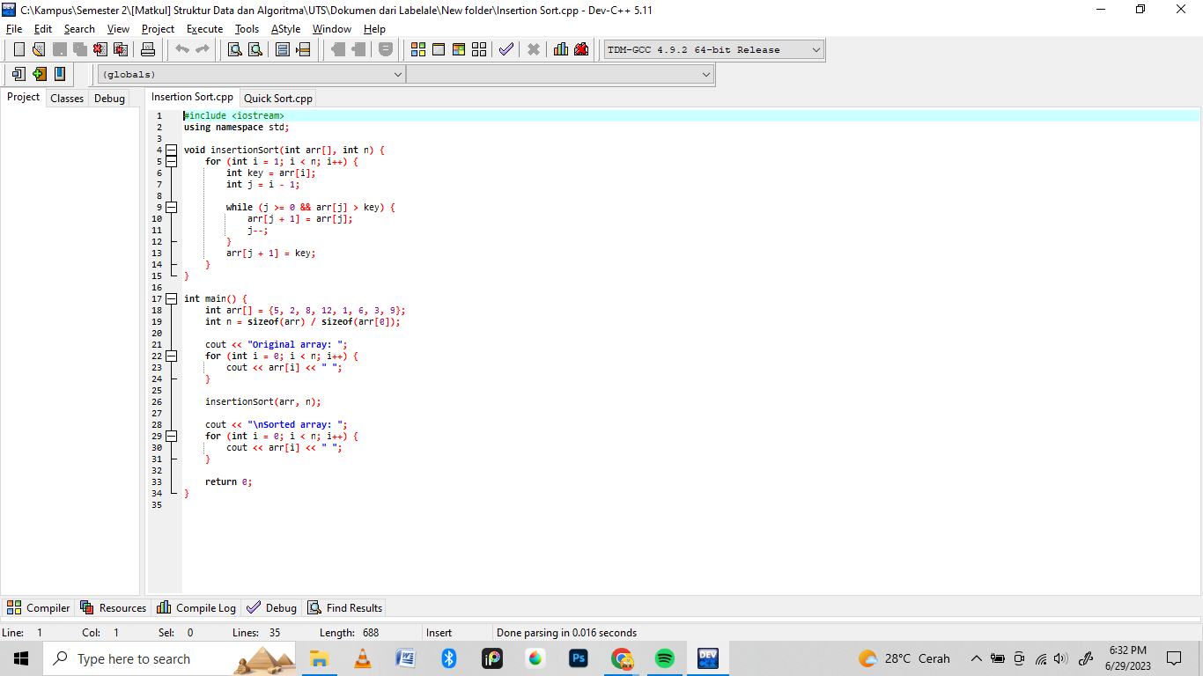
Example Insertion Sort

Slide 5
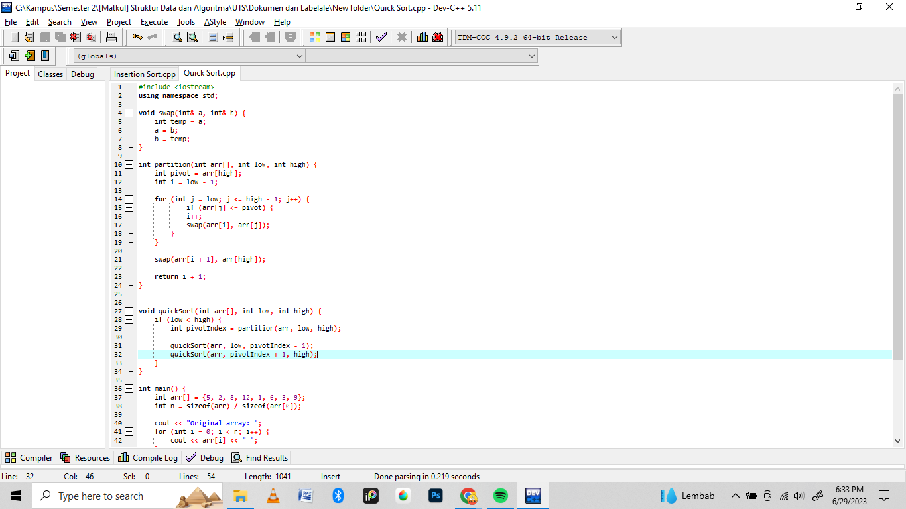
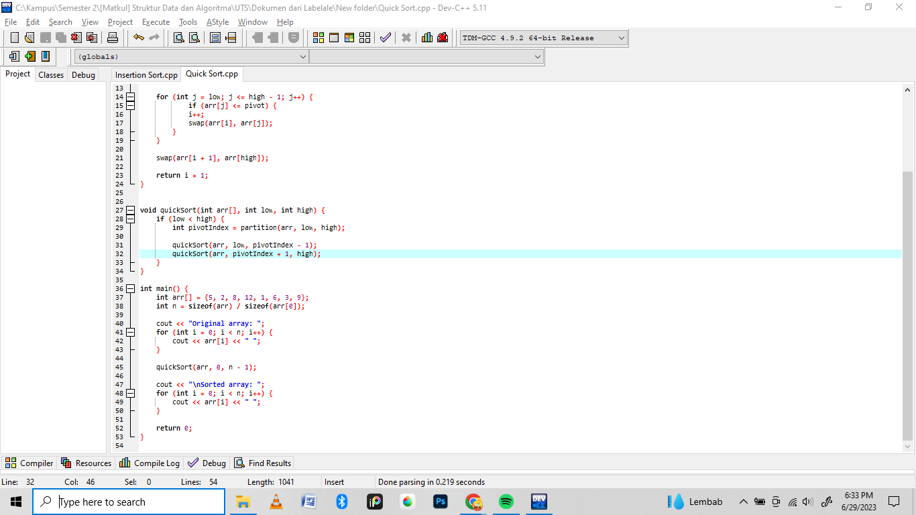
Example Quick Sort

